Slide 1


Slide 2
Esports TOURNAMENT
Challenge link :-esports tournament
Challenge completed by :-Ranjeev Pandey
Linkedin Id:-Ranjeev Pandey
Tools Used:- My SQL, Powerpoint

Slide 3
About the challenge
The top eSports competitors from across the globe have gathered to battle it out. We have to analyze the data using SQL to find out all about the tournament.
In this challenge, we have 3 tables:-
Teams
Players
Matches

Slide 4

About the challenge
Using SQL we have to find out the following:-
What are the names of the players whose salary is greater than 100,000?
What is the team name of the player with player_id = 3?
What is the total number of players in each team?
What is the team name and captain name of the team with team_id = 2?
What are the player names and their roles in the team with team_id = 1?
What are the team names and the number of matches they have won?
What is the average salary of players in the teams with country 'USA’?
Which team won the most matches?
What are the team names and the number of players in each team whose salary is greater than 100,000?
What is the date and the score of the match with match_id = 3?
The

Slide 5

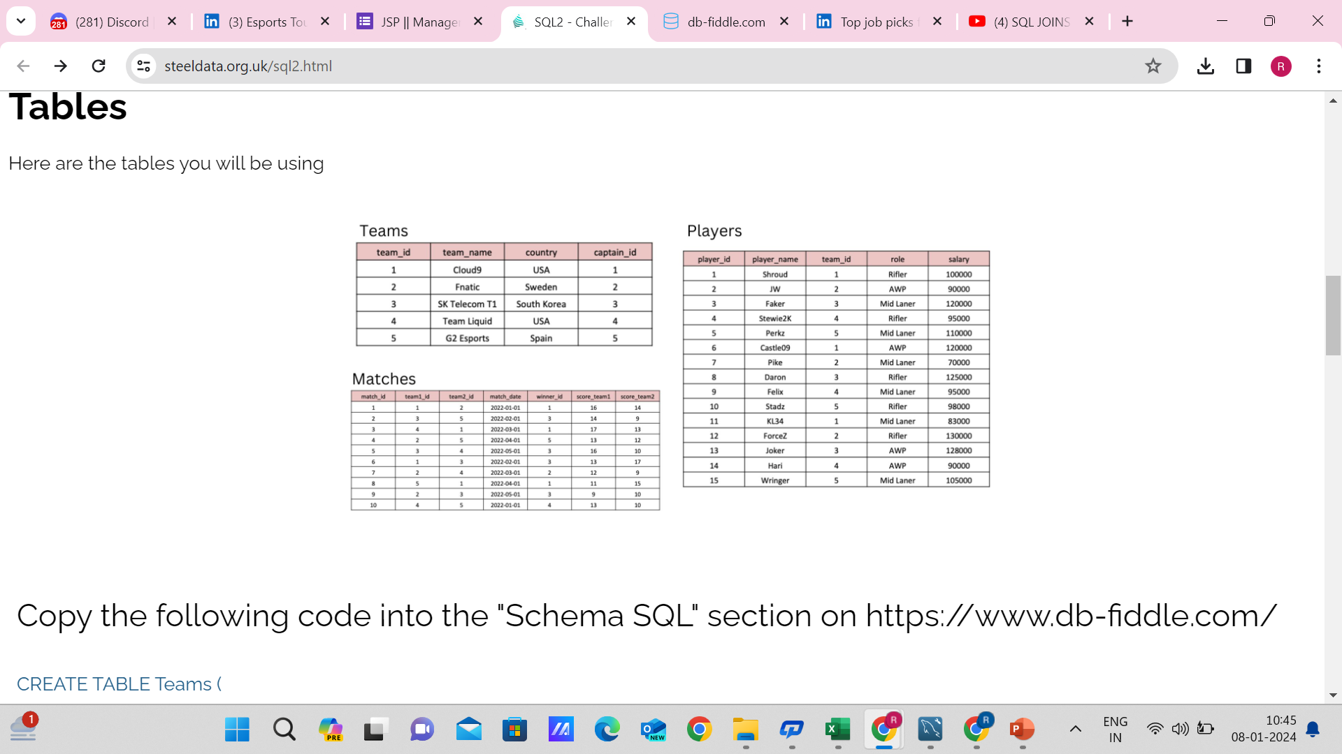
TABLES

Slide 6
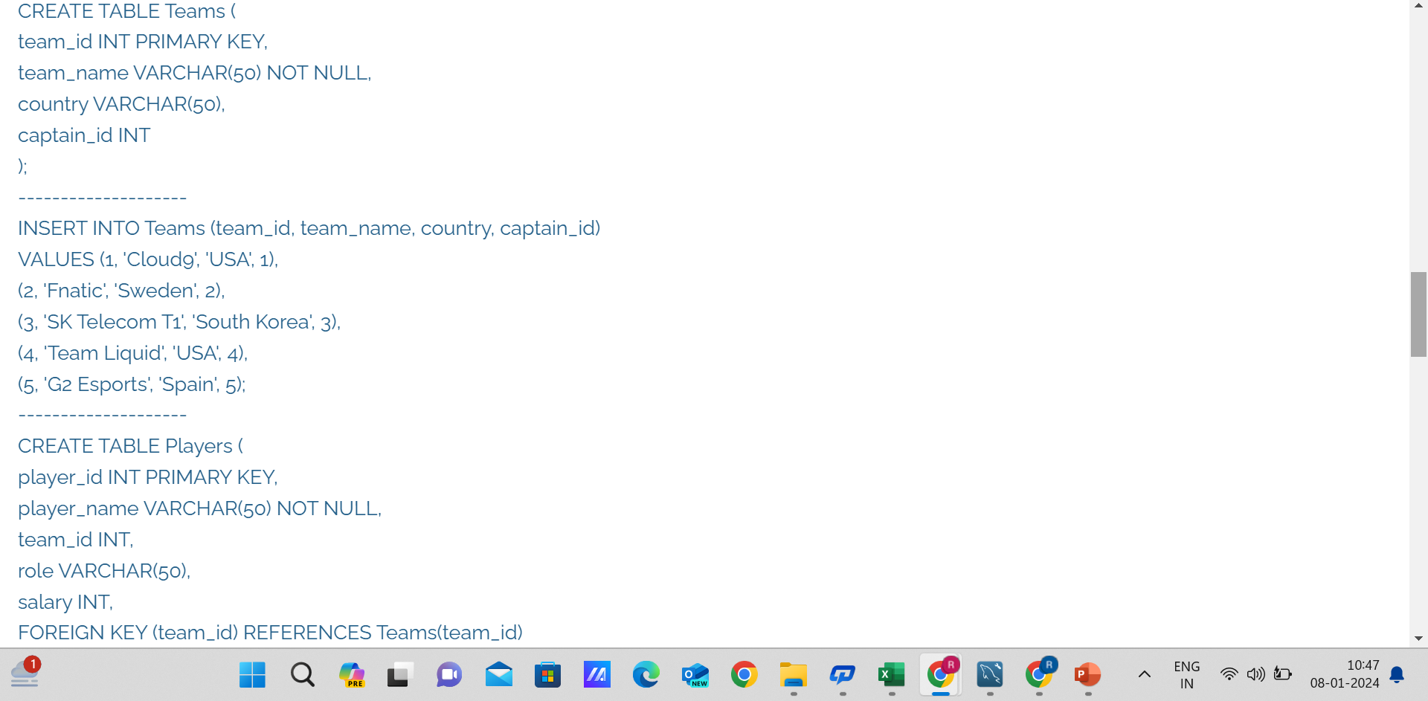

Slide 7
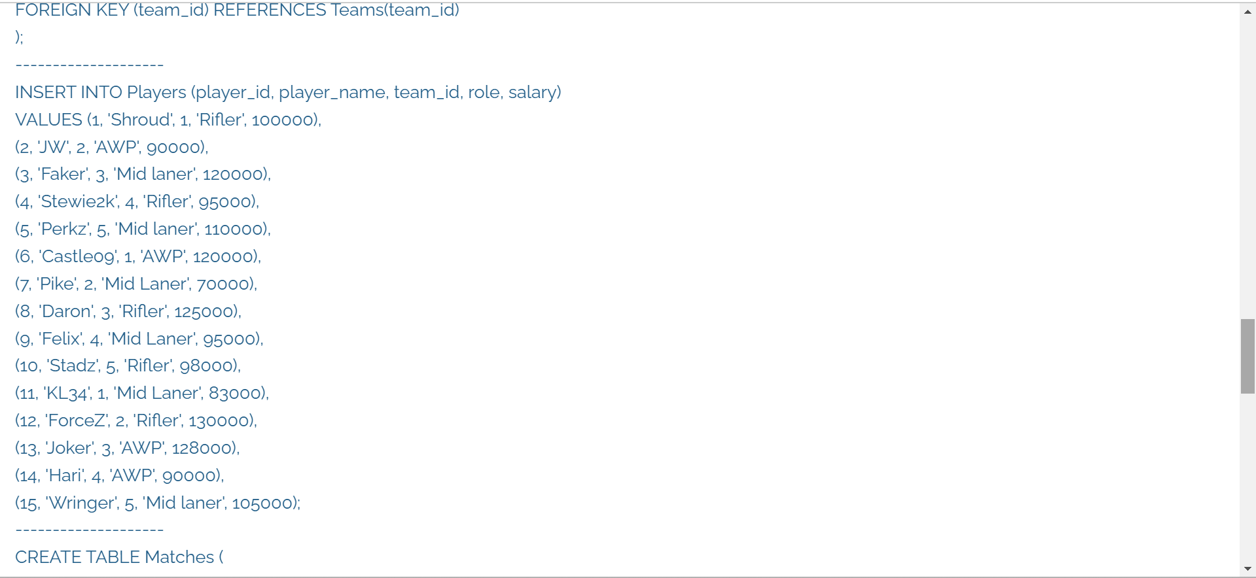

Slide 8
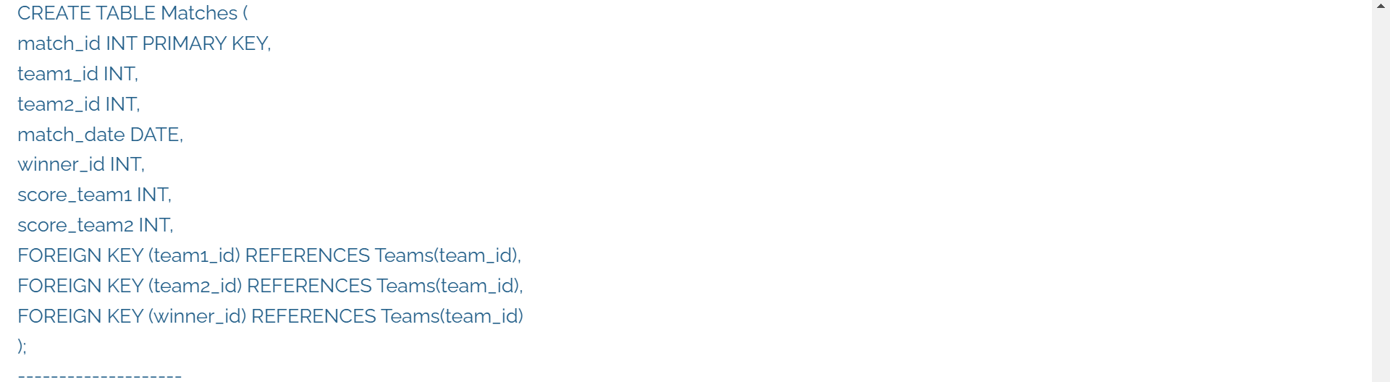
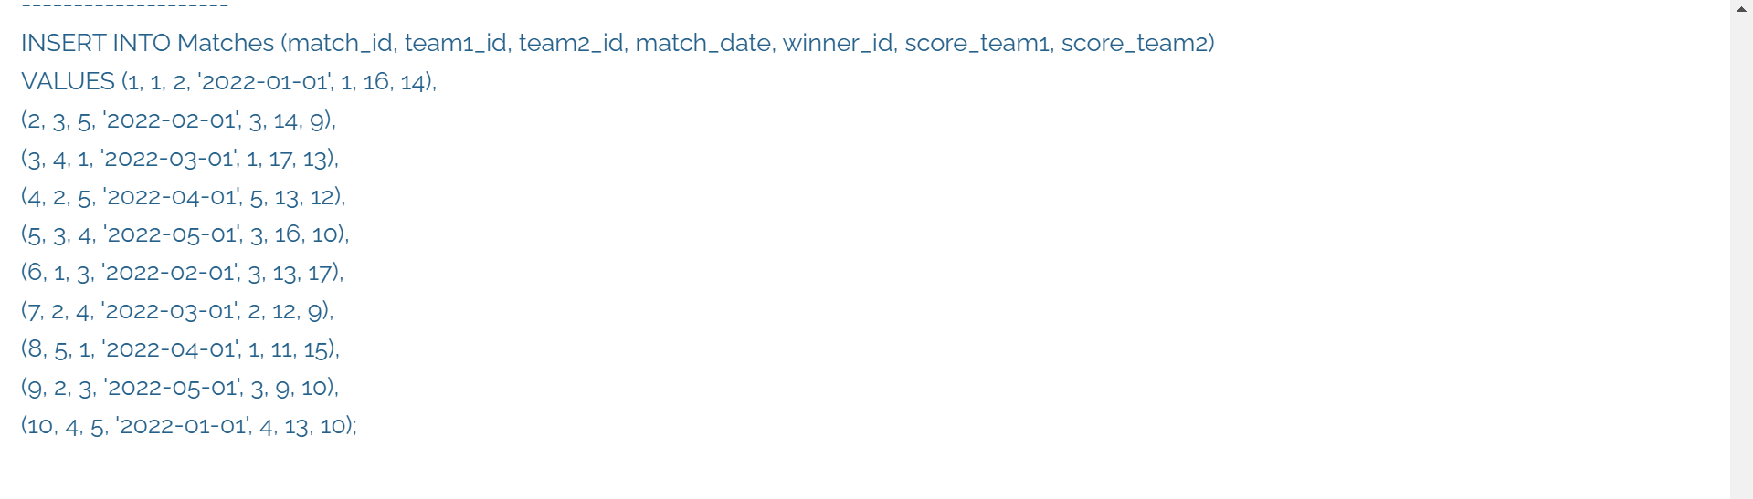

Slide 9
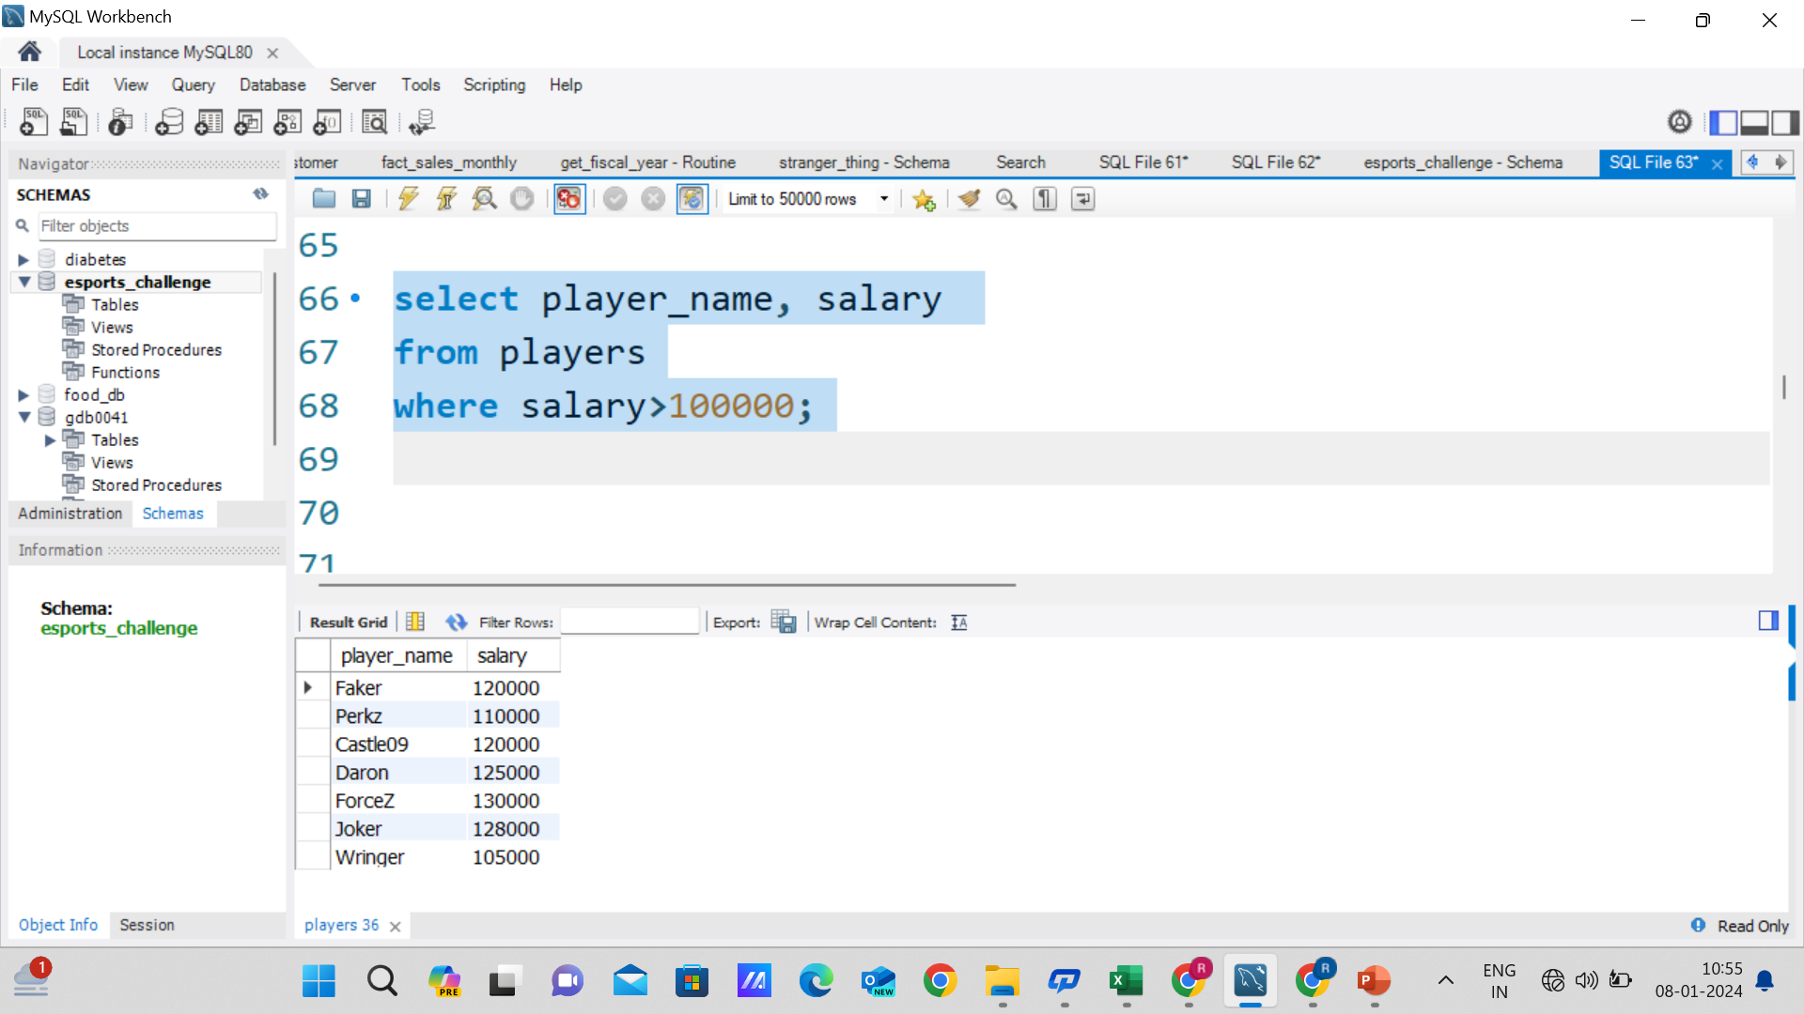
What are the names of the players whose salary is greater than 100,000??

Slide 10
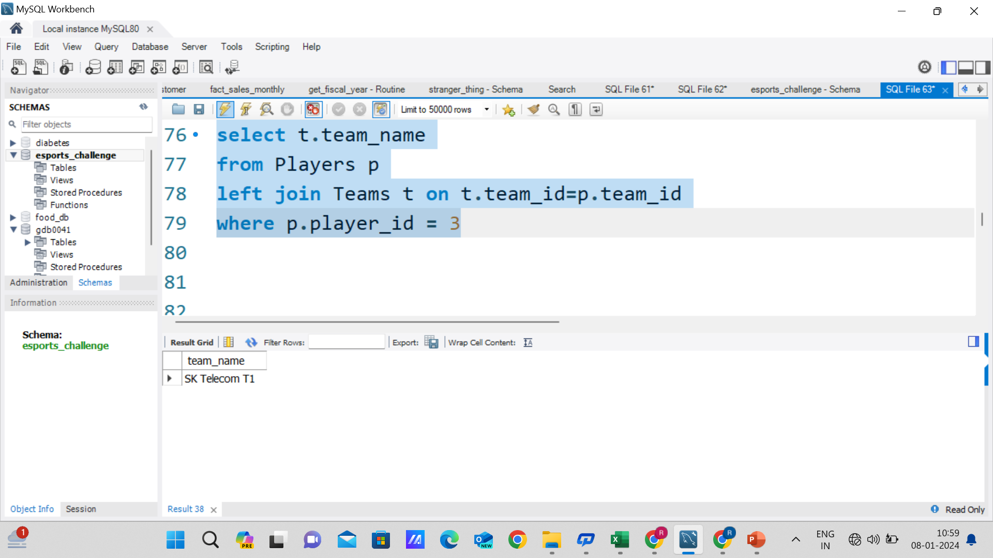
What is the team name of the player with player_id = 3?

Slide 11
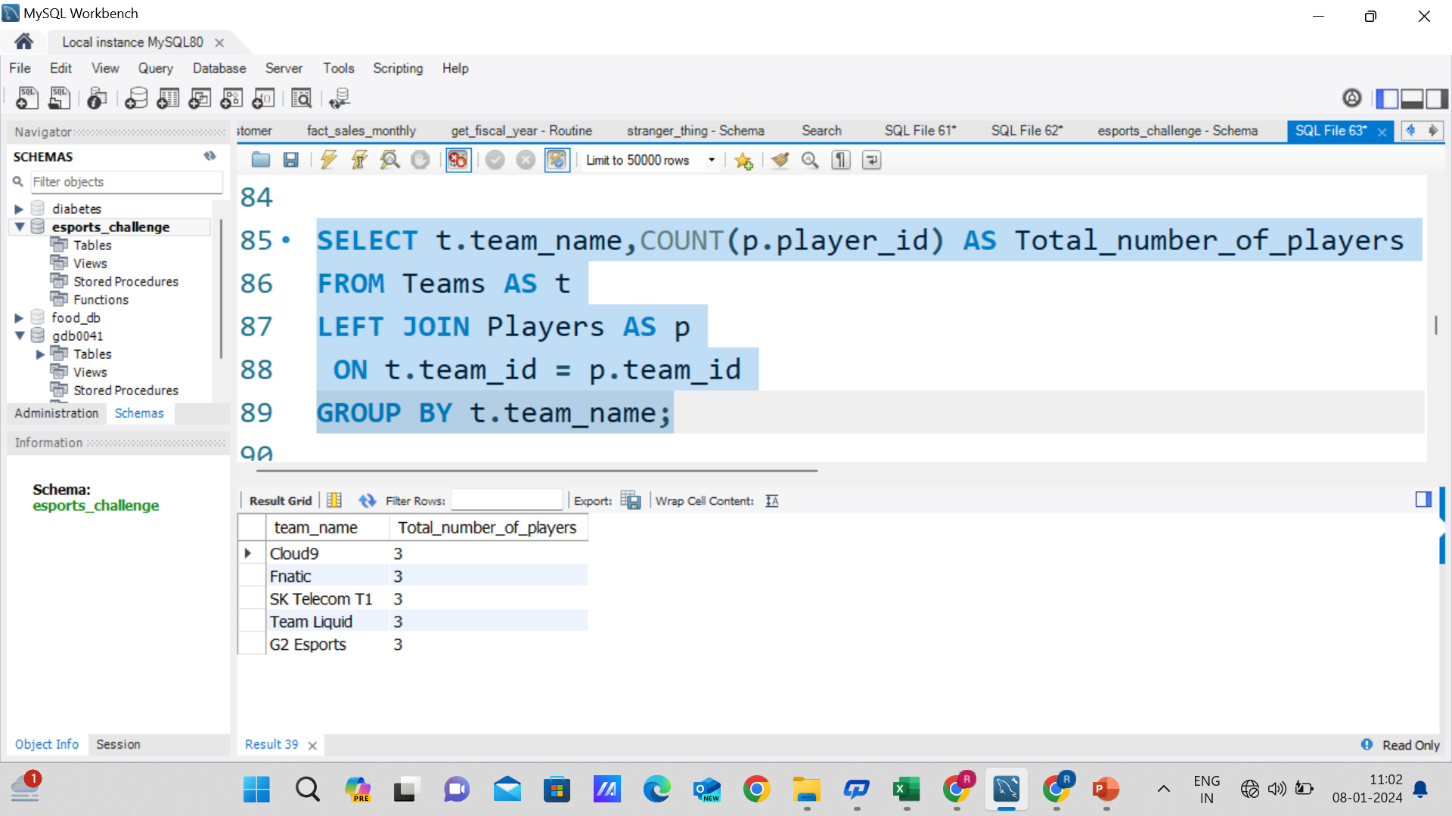
What is the total number of players in each team?

Slide 12
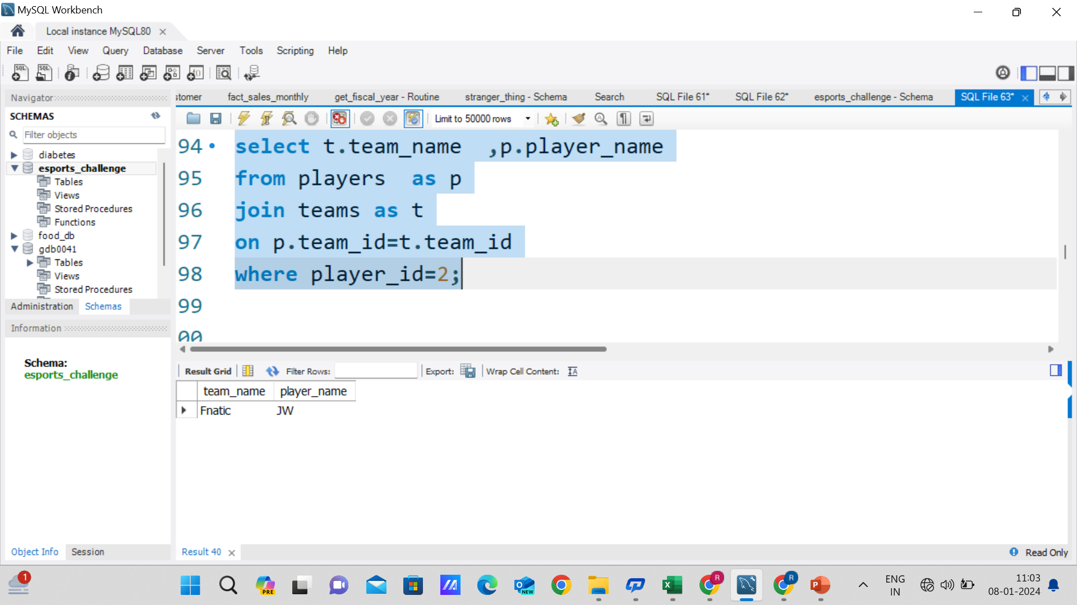
What is the team name and captain name of the team with team_id = 2?

Slide 13
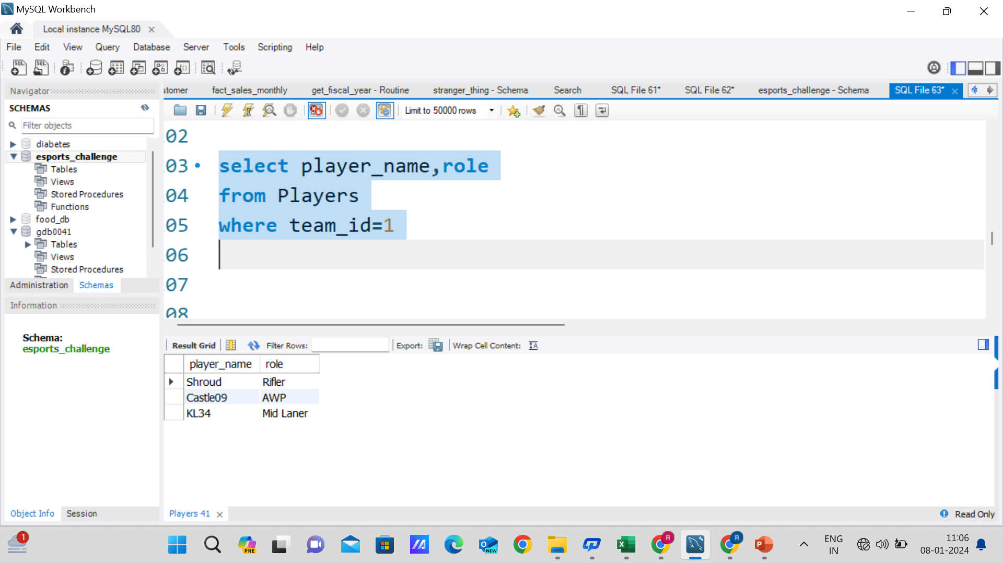
What are the player names and their roles in the team with team_id = 1?

Slide 14
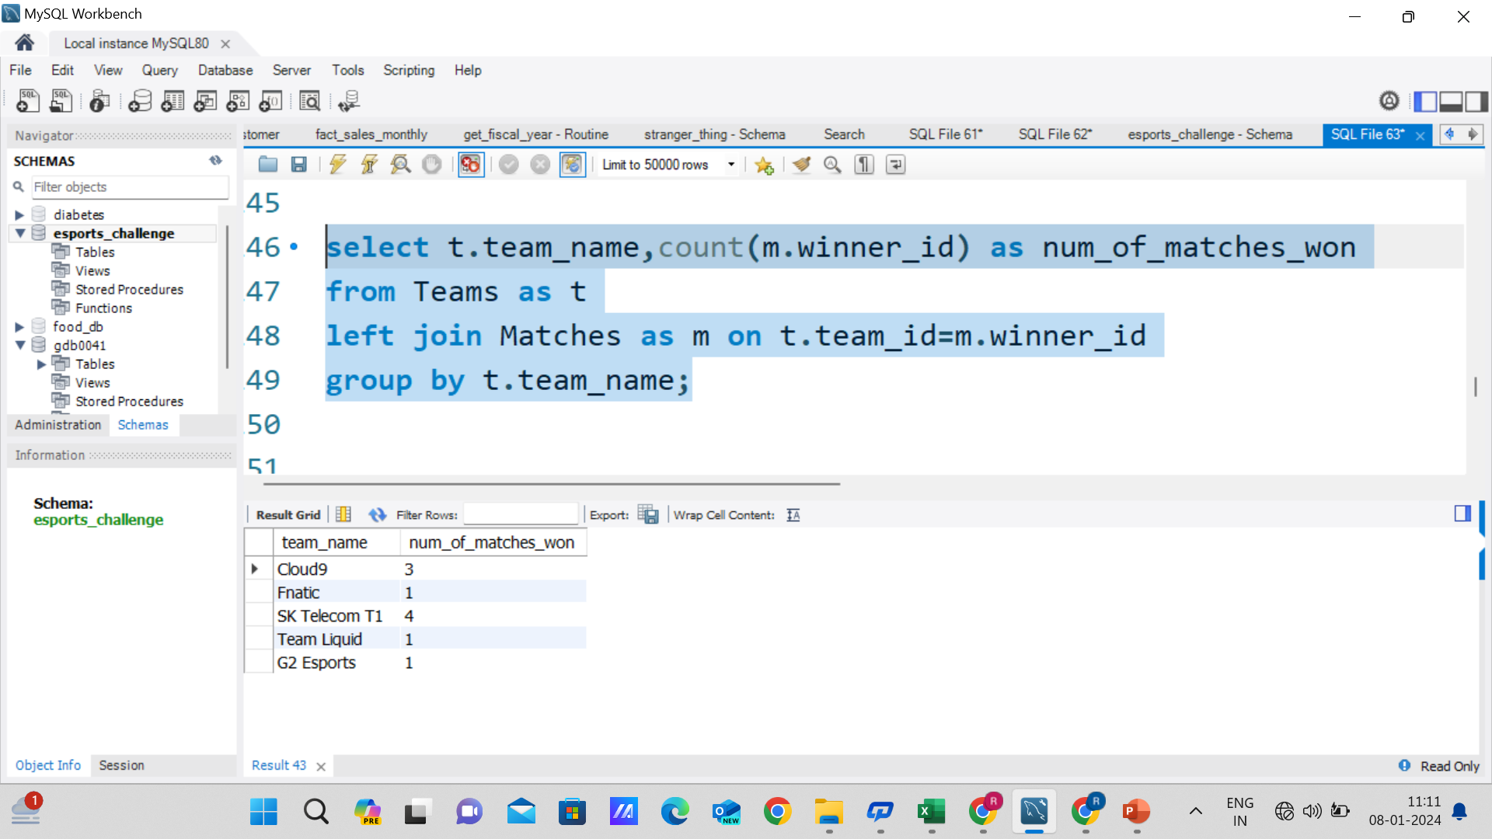
What are the team names and the number of matches they have won?

Slide 15
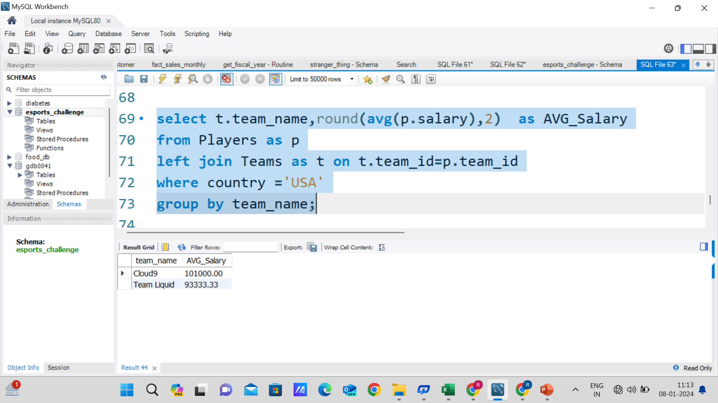
What is the average salary of players in the teams with country 'USA'?

Slide 16
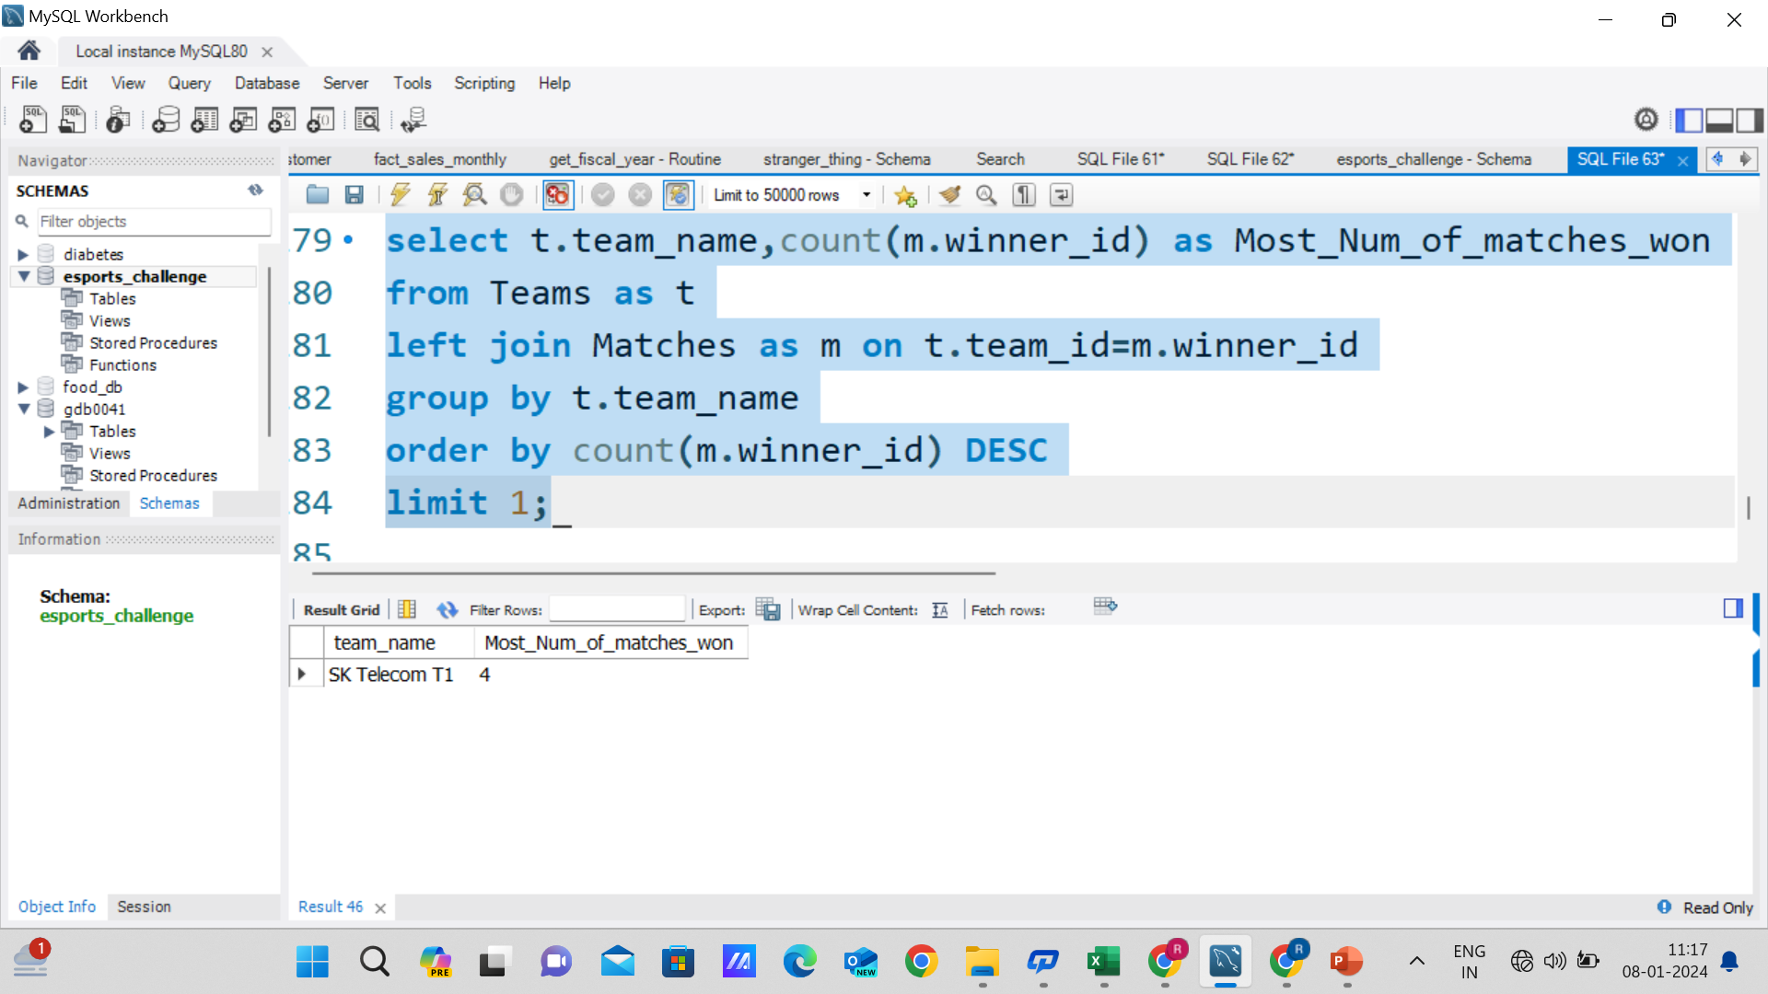
Which team won the most matches?

Slide 17
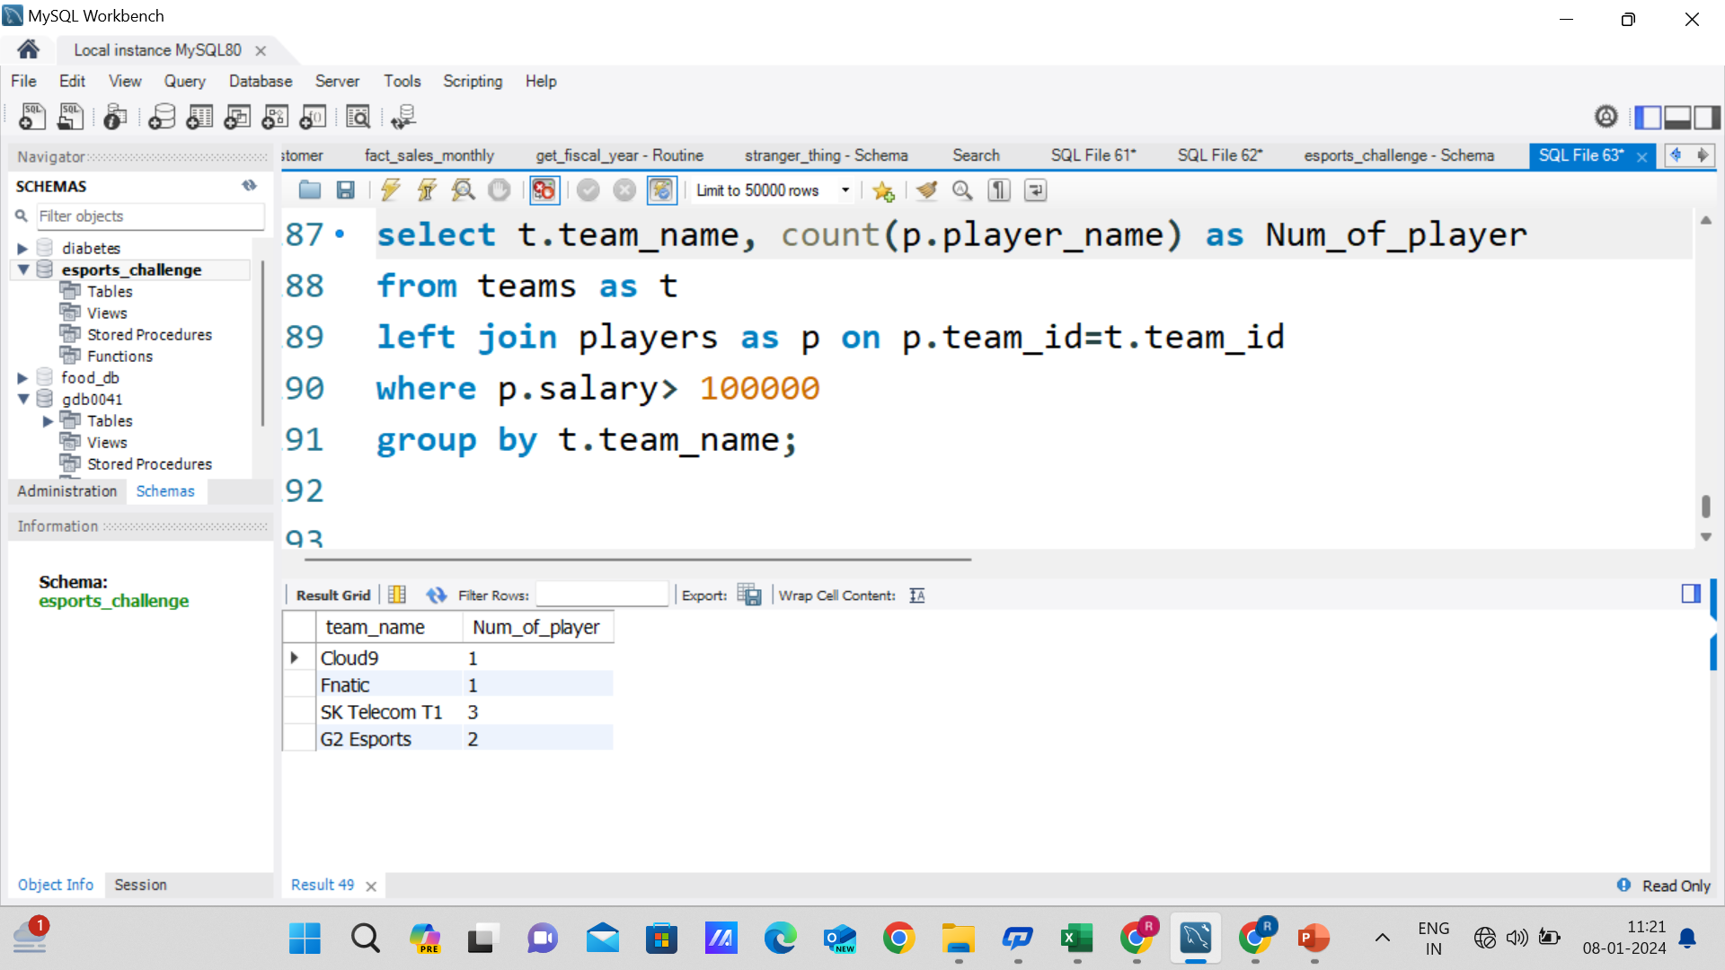
What are the team names and the number of players in each team whose salary is greater than 100,000?

Slide 18
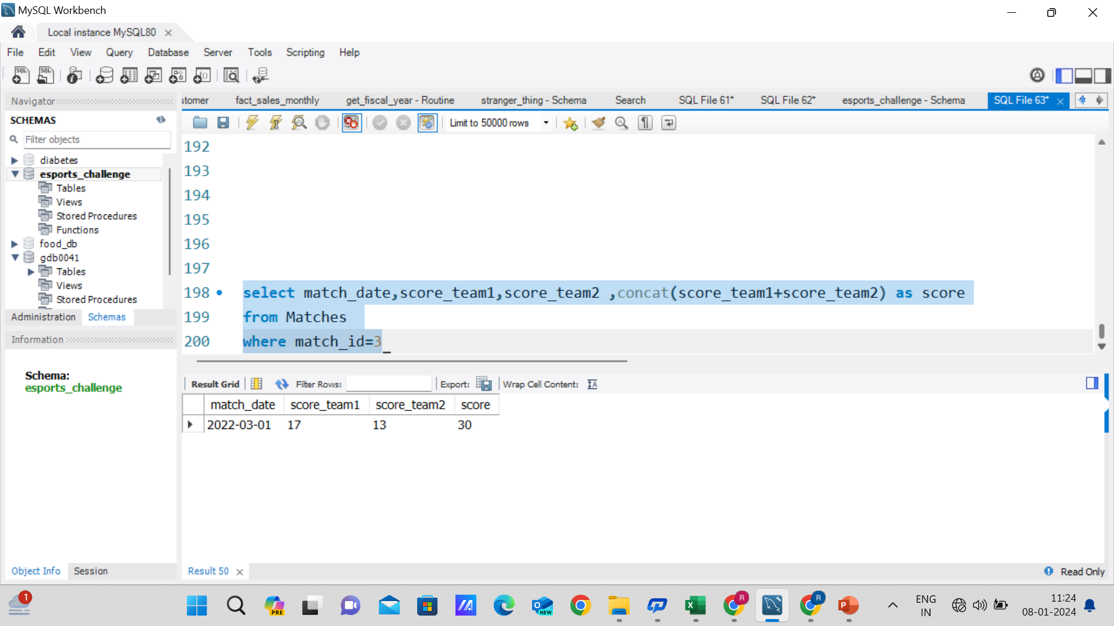
What is the date and the score of the match with match_id = 3??

Slide 19
Learnings:
By solving this project challenge I have learned the various concepts of sql functions which are following:-
Group By
Order By
Join(Left,Right,Inner,full)
Limit
Concat

